Slide 1







CS301
Final Presentation
Project B: Spend Transaction Processing
G3 Team 3 Darren, Frances, Jonathan, Keith, Rafe, Stephen
Notes:
Good afternoon Ascenda management team and profs, my name is Frances and together with me today are Darren, Jon, Keith, Rafe and Stephen and we’re here to convince you of THE solution best architected on AWS that address the Spend Transaction Processing problem statement. —------
Assuming you are the solution architect, and you are presenting your final architecture design of the solution.
Your audience includes the management, development and operation teams. You need to convince the audience with a clear presentation and a solution that addresses their concerns.

Slide 2
Table of Contents
01
Project Context
04
Availability
02
Solution Overview
05
Security
03
Maintainability
06
Performance
Notes:
These are our table of contents starting from the project overview and going into the details of the different features of the architecture.

Slide 3
Project Context
01
Notes:
So before we begin, we’ll revisit the problem statement.

Slide 4
Business Needs
01
Earn Processing
03
Promotional Campaign
Flexibility to launch and close promotional campaigns
Users receive notifications on transactions qualifying for promotions
Daily Transactions Processing for:
Batch processing from files
API
Calculate and show appropriate loyalty points
02
Exclusions
04
User & Card Groups
Exclude processing for certain transactions:
Competing card programs
Special agreements with merchants
User can own multiple cards and the loyalty points will be aggregated according to the same card program
Daily Transactions Processing for:
Batch processing from files
API
Calculate and show appropriate loyalty points
Project Context
Solution Overview
Maintainability
Availability
Security
Performance
Notes:
Here are the 4 business needs drawn from the requirements document.
For Earn Processing, the solution must be able to ingest transactions data from two data sources: csv files from ExaVault and API calls. These will then be processed and loyalty points gained from the transactions will need to calculated and shown on a user interface.
For Exclusions, takes into consideration the certain exemptions for loyalty points calculation for certain transactions due to competing programs and/or agreements with merchants
We then have the Promotional Campaign where the merchants should have the flexibility to start and close campaigns programs and the respective points calculated at the point of time of transaction processing. Users would also be notified when any of their transactions qualify for certain campaigns.
Lastly, each user can own multiple cards, and for the same type of card program, the loyal point should be aggregated.

Slide 5
Stakeholders
Business Stakeholders
IT Stakeholders
Daily Transactions Processing for:
Batch processing from files
API
Calculate and show appropriate loyalty points
Amazon Web Services (AWS)
Ascenda Loyalty Developers
Campaign Administrators
ExaVault
Client – Users of Merchants
Marchant Managers
SCIS Bank
Ascenda Loyalty
Project Context
Solution Overview
Maintainability
Availability
Security
Performance
Notes:
These are the stakeholder our solution is built for. For the business aspect we have the client, users of the cards, merchant managers, SCIS bank and the Ascenda Loyalty. For the IT stakeholders, we have AWS, Ascenda Loyalt’s Developers, Campaign Administrators and the Exavault file system.

Slide 6
Use Cases
01
High Data Inflow for Transaction Processing
Daily Transactions Processing for:
Batch processing from files
API
Calculate and show appropriate loyalty points
Data from Merchants
API calls transactions API to process the transaction
Data from ExaVault
At 12mn daily, Lambda will pull files from Exavault to AWS S3 which will trigger the file conversion and process the transactions
Data processing from SQS
Transaction Processors will execute calculator processes based on the different business logic
Processed transactions placed into the Amazon Aurora
Transactions that fall under another campaign will be sent to another queue to notify the customer on their rewards
Project Context
Solution Overview
Maintainability
Availability
Security
Performance
Notes:
Our first use case would be the high data inflow for transaction processing where data from merchants are received from API callas and batches of data received from ExaVault at 12 midnight daily. The data will then be sent to be processed using SQS where the respective processing can take place which will be explained later in the presentation.

Slide 7
Use Cases
02
Confidentiality & Integrity of Transactions & User Data
Daily Transactions Processing for:
Batch processing from files
API
Calculate and show appropriate loyalty points
Encryption
AWS services such as S3, DynamoDB and SQS are encrypted with encryption keys managed by the respective services
PII and PCI data are encrypted at rest in the respective AWS services
Use AWS Certificate Manager to provide an SSL certificate (HTTPS) on our domain
Securing access controls
Application of IAM roles with least privileged access given to every service
Database are placed in private subnets and accessed only by certain IPs
Restriction of AWS services using Security Groups and Network Access Control Lists (NACLs)
Login Variables via SFTP are stored in environment variables within the AWS Lambda
Project Context
Solution Overview
Maintainability
Availability
Security
Performance
Notes:
Our next use case which is about the confidentiality and integrity of sensitive information. So we apply encryption on the different services as we as apply SSL cert on your domain. For securing of access, we apply IAM roles with the least privilege access and restrict access to key services as our database. Any login information are also stored in environment variables reducing sensitive information existing in our code.

Slide 8
Use Cases
03
System Availability and Reliability with Disaster Recovery Measures
Daily Transactions Processing for:
Batch processing from files
API
Calculate and show appropriate loyalty points
Continuous Integration of frontend:
GitHub Actions can be triggered to redeploy frontend at at any point of failure
Hosting container on ECS
Configured to run as ECS Services so when a container fails or stops, it is automatically replaced
Spin up of services with ECR and Terraform
Ease of bringing architecture back up with Infrastructure-as-Code (Terraform)
Project Context
Solution Overview
Maintainability
Availability
Security
Performance
Notes:
In our last use case which emphasis on availability and reliability we make use of Github actions to redeploy our front end. Our microservice containers are all hosted on ECS so with faregate, containers can be easily replaced if any issues are faced and lastly we have Terraform which restores all the services in case of any failure.

Slide 9
Solution Overview
02
Notes:
Moving on to our team’s solution overview.

Slide 10
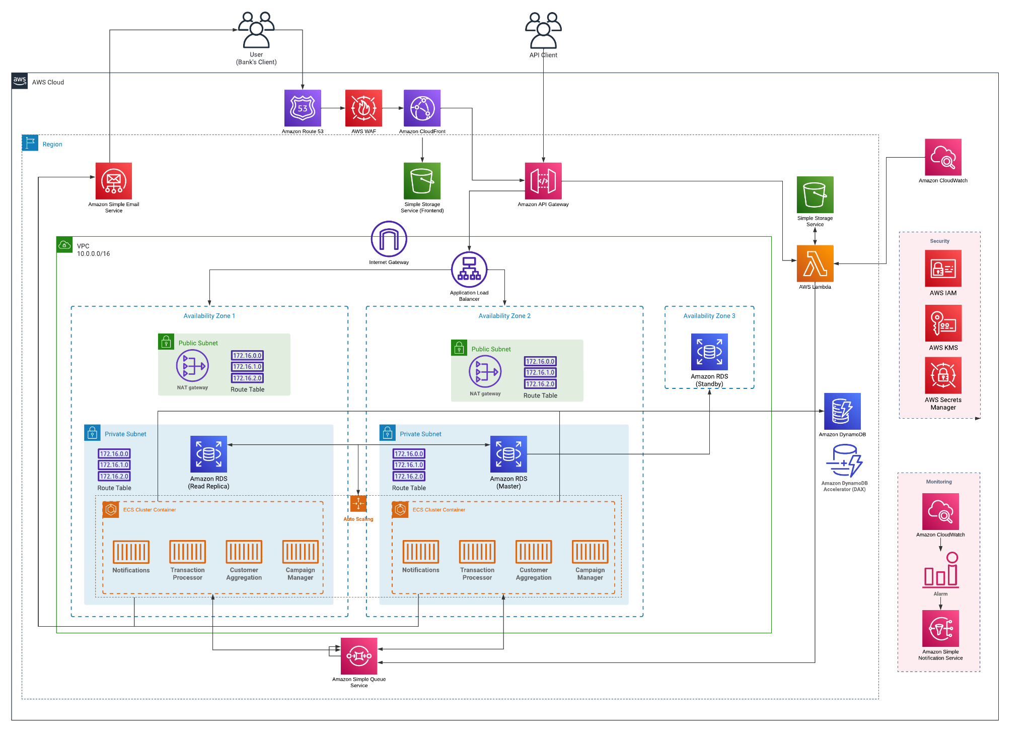
Our Proposed Architecture (Proposal Phase)
1
4
Frontend Web (for users)
Earn Processing
3
Campaigns & Exclusion
2
Security
Project Context
Solution Overview
Maintainability
Availability
Security
Performance
Notes:
Our original architecture in the proposal phase were broken down into 4 key components:
the frontend web,
earn processing,
campaigns,
exclusion and security.

Slide 11
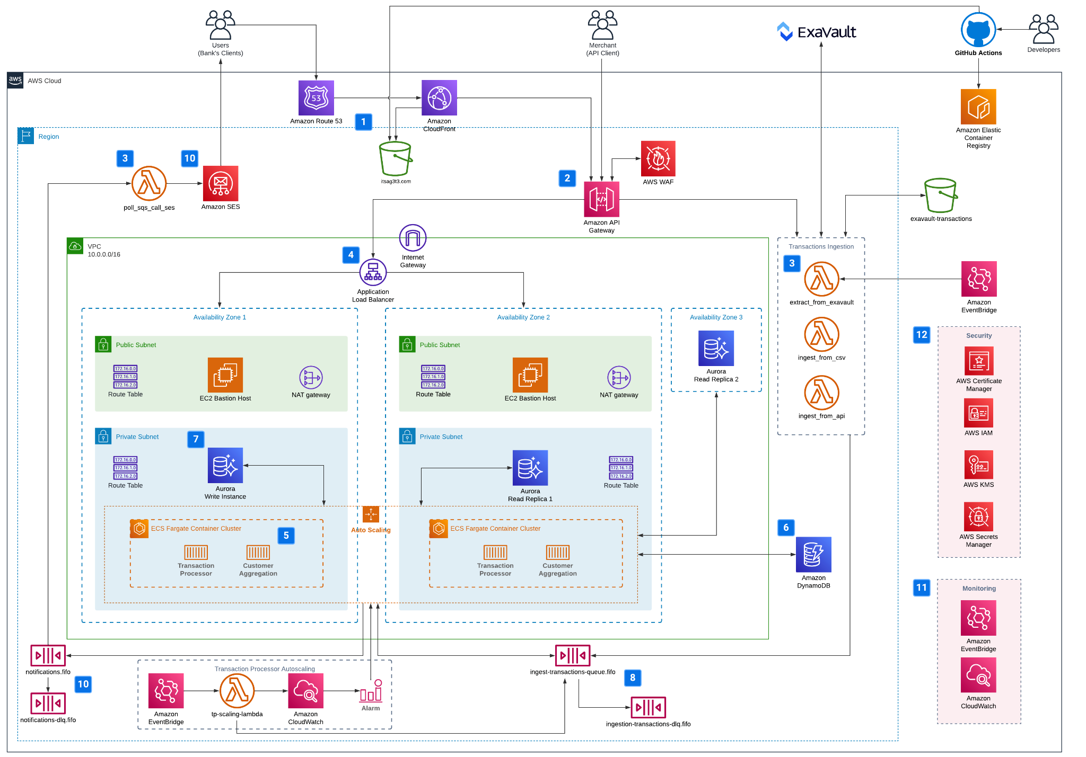
Our Proposed Architecture (Now)
Frontend Web (for users)
Earn Processing
Campaign Notification
Security
Ingest Transactions
Project Context
Solution Overview
Maintainability
Availability
Security
Performance
Notes:
After some revision, this is our revised proposed architecture.
There are 5 main areas that we have grouped our architecture into:
The first 2 components and Security are the same as before,
And we have identified 2 new components which are ingest transactions and campaign notification.
What’s new and different in our current architecture is that we have:
Shifted WAF to the API gateway
Included CI/CD
Removing DynamoDB DAX (changing our caching strategy)
Module for scaling ECS tasks based on items in the queue
The change of using RDS to Amazon Aurora
All these changes will be explained further in later parts of this presentation.

Slide 12








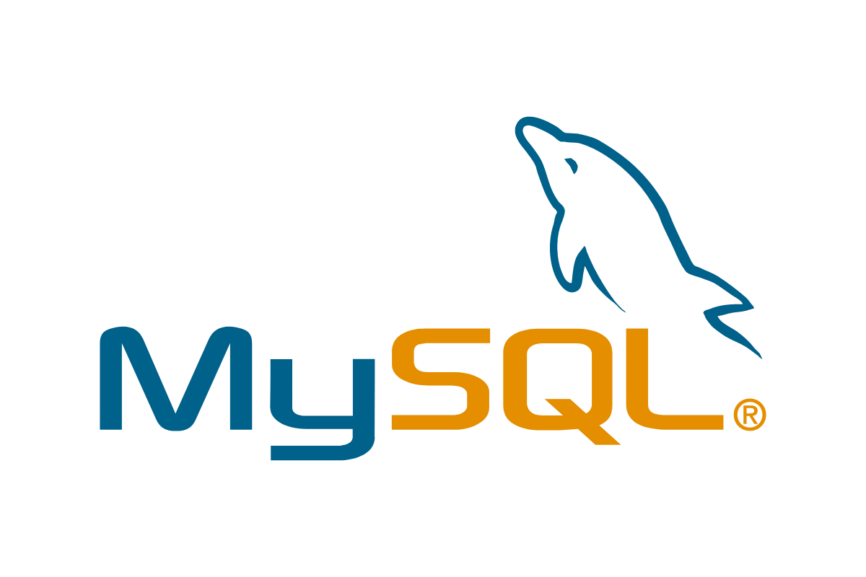


3-Tier Architecture
Presentation
Amazon S3
Amazon Route 53
Amazon CloudFront
Application
Amazon API Gateway
Amazon ECS
AWS Lambda
Data
Amazon DynamoDB
Amazon Aurora
Project Context
Solution Overview
Maintainability
Availability
Security
Performance
Notes:
When building our architecture, we organised our applications into 3 logical and physical computing tiers.
We chose to use this 3-tiered architecture as these layers can be developed simultaneously by different group members and each tier can be scaled without impacting the other tiers.
The Presentation Layer is the user interface of our application. Users will be able to view their transactions over here.
The Application Layer is where we handle the business logic and process our transactions based on the business rules given.
Lastly, in the Data Layer, this is where all our transactions and user information and business rules are stored.

Slide 13
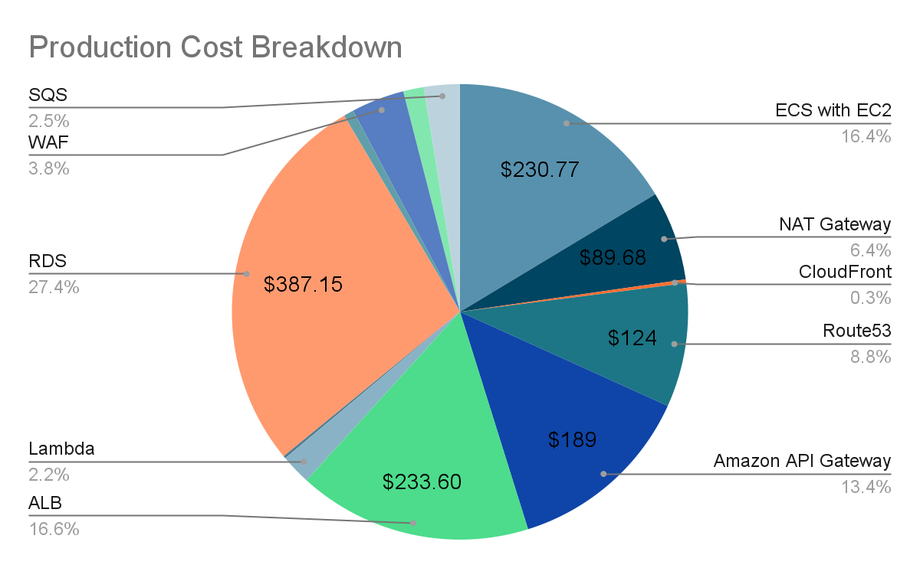
Overall Costs (Proposal Phase)
Estimated Total: $1410.39 per month
Project Context
Solution Overview
Maintainability
Availability
Security
Performance
Notes:
Moving on to the overall cost of our architecture, this was the overall costs breakdown back in our proposal phase which was about $1,400.

Slide 14
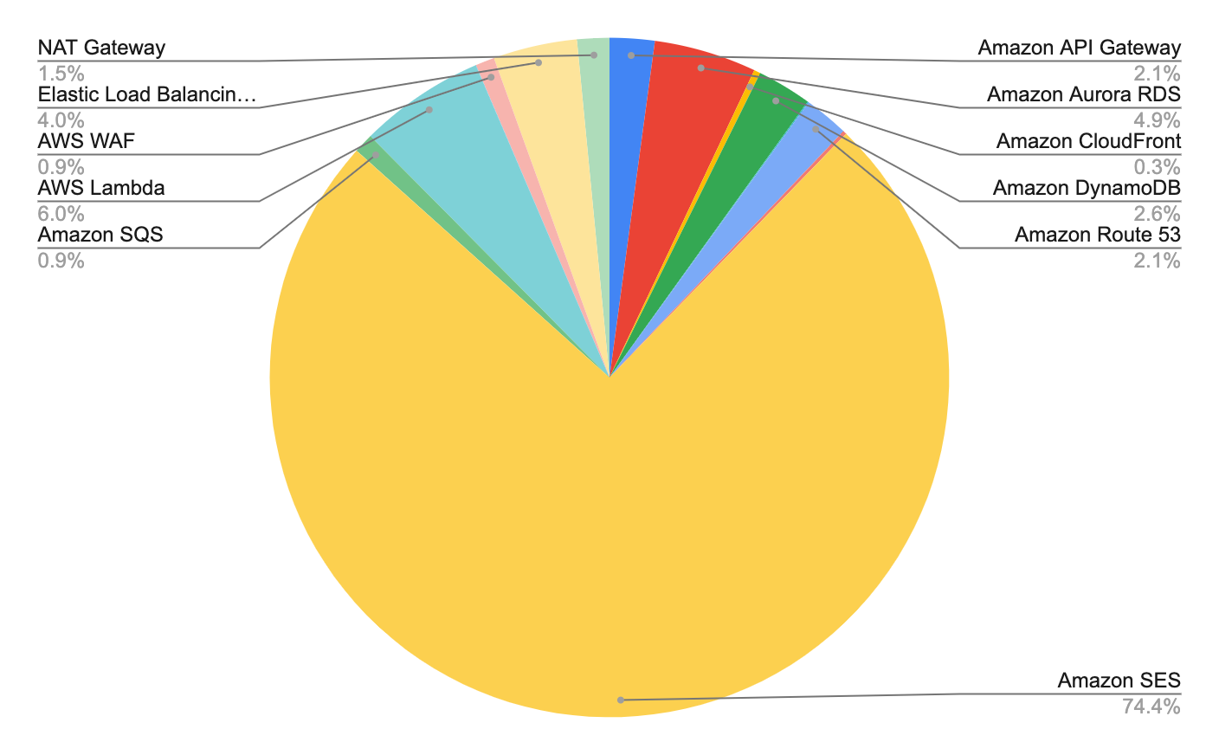
Overall Costs (Now)
Estimated Total: S$5,849.27 per month
Project Context
Solution Overview
Maintainability
Availability
Security
Performance
Notes:
And this is our overall cost now, which totals up to about $5,800.
The reason for the huge cost for Amazon SES is because of the assumption made, which is given 62 million transactions in a month, we assume half of them qualify for campaigns.
However, we understand that this may not be the case for every month and we re-calculated another cost for SES with a lower bound of monthly transactions based on the historic data from ExaVault.

Slide 15
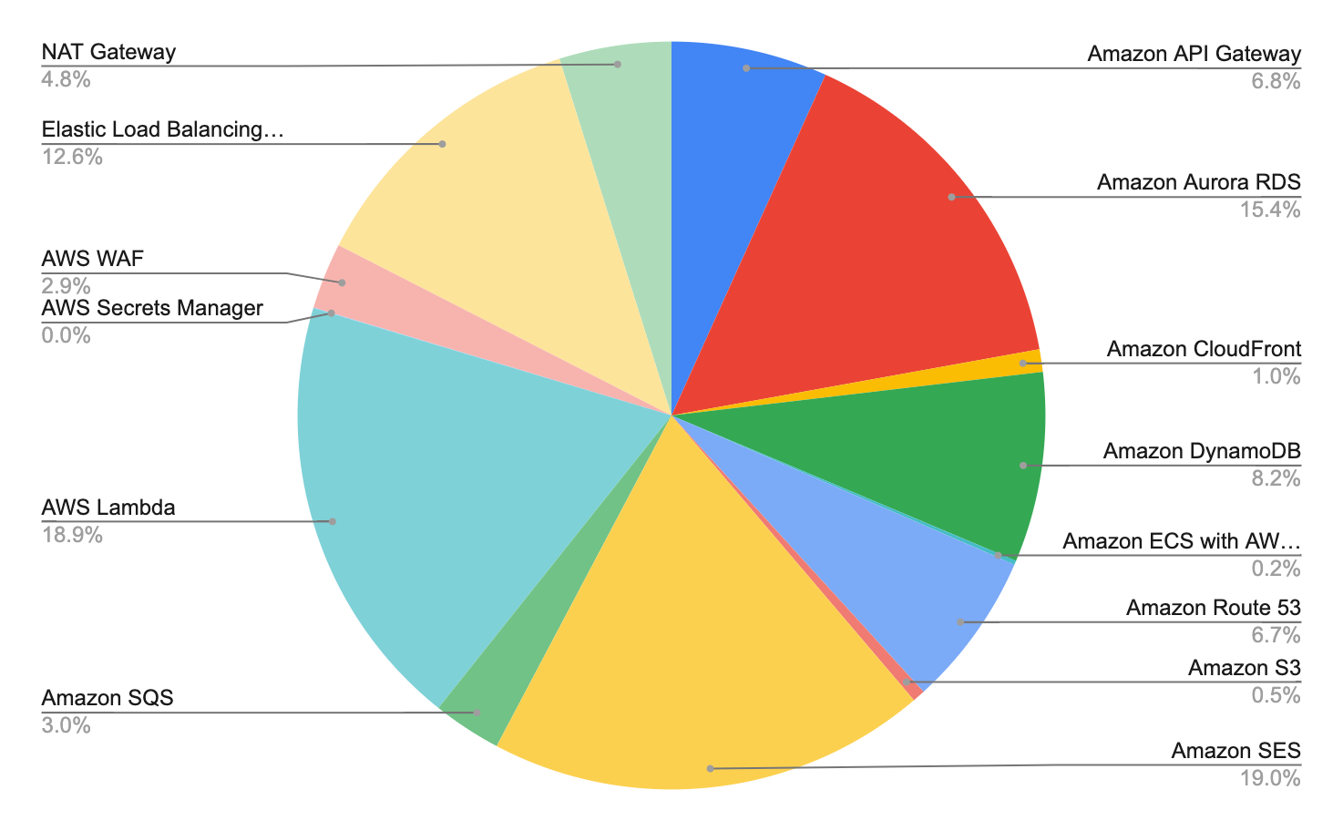
Overall Costs (Now)
Estimated Total: S$1849.99 per month
Project Context
Solution Overview
Maintainability
Availability
Security
Performance
Notes:
Over here, the assumption is that the number of monthly transactions is 5 million and half of that qualify for campaigns.
This greatly reduces the cost of using Amazon SES and can give us a better view of the cost breakdown of the other services used.
Given more time, our team will explore other 3rd party email delivery platforms to lower the cost of SES so that we can use the budget on other aspects of the architecture.

Slide 16
Frontend Demo
https://www.itsag3t3.com
Project Context
Solution Overview
Maintainability
Availability
Security
Performance
Notes:
We will now proceed with the demo of the frontend application.

Slide 17
Pipeline Demo
Transaction Pipeline Flow
Project Context
Solution Overview
Maintainability
Availability
Security
Performance
Notes:
Send api req via postman, stephen should receive email
Planning to show each service and explain what they do and who they communicate with

Slide 18
Maintainability
03
Notes:
rafe

Slide 19
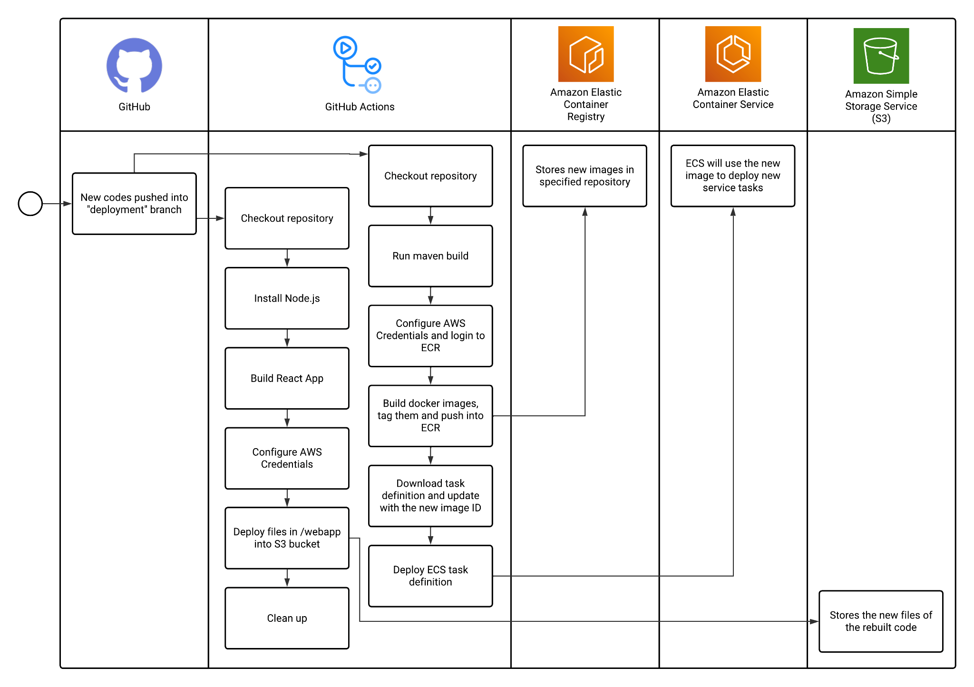
Development Process
GitHub Actions triggered on push to development branch
ECR helps to maintain proper versioning of images
Pipelines help us modify and update our services with no downtime
Project Context
Solution Overview
Maintainability
Availability
Security
Performance
Notes:
To help facilitate the deployment of code changes, we set up github actions workflows. To illustrate, for our transaction processor, once new features are pushed into our deployment branch the workflow is automatically triggered. GitHub Actions will checkout our code repo, build a new container image and push it into Amazon’s Elastic Container Registry. With ECR we maintain proper version control of all our application images and can revert to an older image if need be.
Following that it would update the ECS task definition to use the new image ID, so ECS could use the new image to deploy new transaction processors.
We have similar workflows for the rest of our services such as pushing new React builds to S3 for our frontend.
These pipelines helps us to modify and update our services more efficiently and conveniently with no downtime.

Slide 20
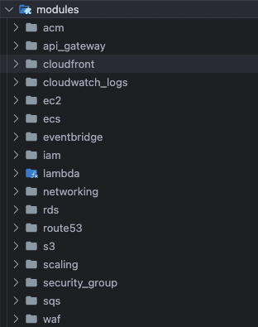

Development Process (IaC)
Infrastructure as Code (Terraform)
Enterprise-level infrastructure
Spin up, scale up and teardown efficiently
IaC Design Structure
Decouple AWS services by modules to keep resources as plain as possible for ease of reference
Project Context
Solution Overview
Maintainability
Availability
Security
Performance
Notes:
We also use Terraform for our Infrastructure as Code, which helps us to spin up, scale up and tear down infrastructure resources efficiently.
We also separate the services by modules to keep resources organized for ease of reference. This, along with Terraform’s straightforward and simple syntax, allows us to make changes more easily.
With Terraform, instead of clicking through the console or making untraceable cli commands to change resource configurations, we simply make changes to our terraform repository and apply the changes.
Descriptive and auditable.

Slide 21
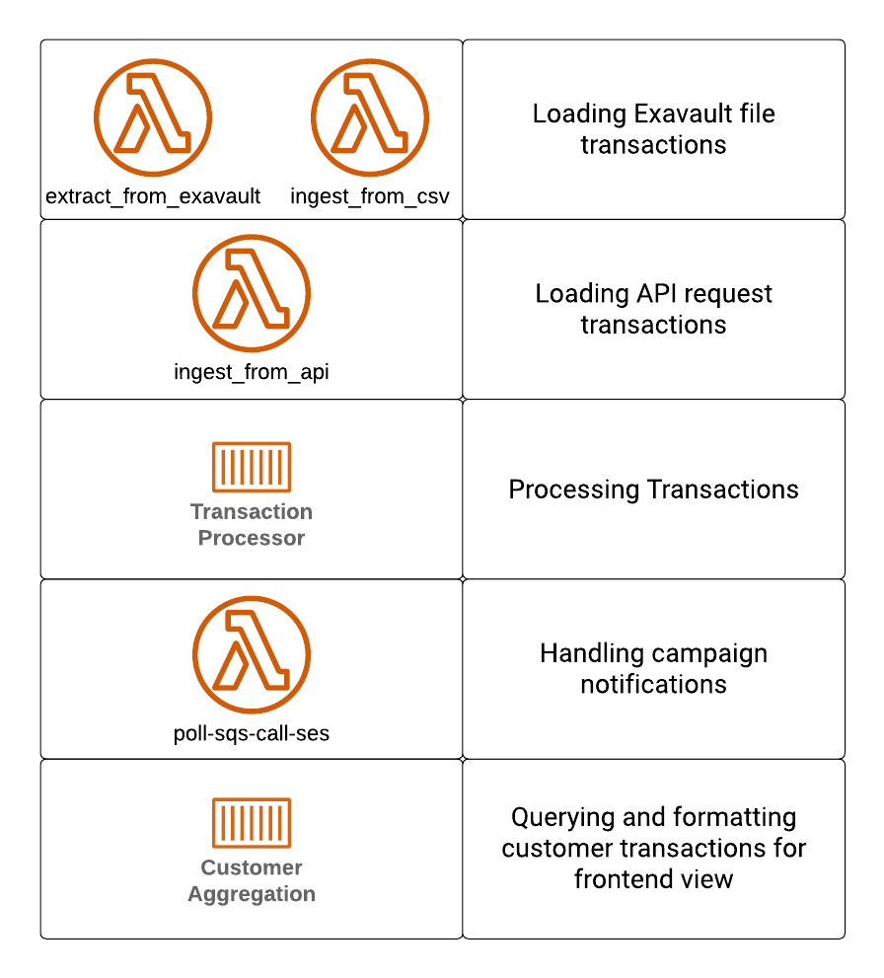
Microservices with ECS, Lambda
Allows us to increase the modularity of our services and analyze each service’s computing resource needs clearly
Allows us to scale different parts of the solution separately
Minimize dependencies between services
All we need are agreed-upon data models / API contracts
Project Context
Solution Overview
Maintainability
Availability
Security
Performance
Notes:
We also identified and broke down our solution into various functions, such as services for querying, ingesting and processing transactions, and campaign notifications. These individual parts are maintained and deployed separately as microservices with lambda and ECS.
Doing so allows us to increase the modularity of our solution and analyze each service’s computing resource needs clearly. It also allows us to scale different parts of the solution separately and achieve more effective resource utilization and cost savings.
Maintainability is also achieved by minimizing dependencies between services so we can focus each change on a specific service and have faster development speed.

Slide 22
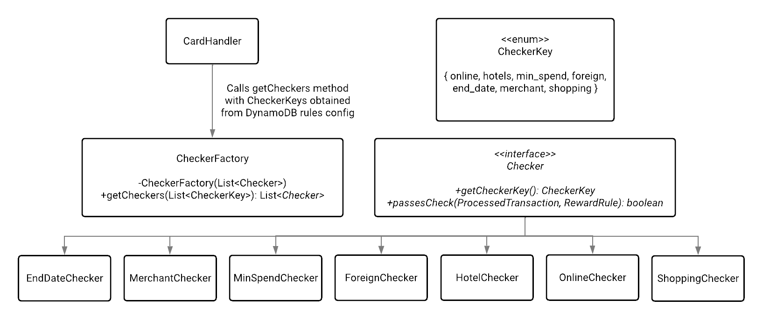
Factory Method Design Pattern
Open-Closed Principle:
Introduce new Checkers without modifying existing client code
Single-Responsibility Principle:
Checker creation code is only moved to CheckerFactory
Each Checker performs its own specific check
Instead of littering our code with multiple conditionals and repeating code for similar checks (violating DRY), we use the Factory Creational Pattern.
Avoid tight coupling between CardHandler and concrete Checkers
Project Context
Solution Overview
Maintainability
Availability
Security
Performance
Notes:
For our design patterns, we chose to implement the factory method creational pattern, as we noticed that there are numerous checks required to determine base earn and campaign earn eligibility for various card types. And while they are rather unique amongst the card types and campaigns, it is not unforeseeable that in future they may overlap. So instead of littering our code with multiple nested conditionals and repeated code for similar checks, we decided to use this design pattern.
Firstly, all our business config and card rules are stored inside dynamodb, which is retrieved and cached hourly by our transaction processor service.
The CardHandler calls the getCheckers method of CheckerFactory with the required CheckerKeys, which is stored inside our card rules.
This avoids tight coupling between CardHandler and concrete Checkers. It achieves the Open-Closed Principle as we can introduce new checkers easily without modifying existing client code. All we have to do is create a new concrete checker class and update our CardRules table in dynamodb for cards that require this check.
Lastly, we adhere to the single-responsibility principle as checker creation code is only contained in CheckerFactory, with Each Checker performing its own specific check. This makes the code easier to support and maintain.
We also use the Factory Method Design Pattern for our earn calculation, though currently there is only one type which is the RateCalculator, in future if we have more complex points calculation we can extend that as well.

Slide 23
Availability
04
Notes:
Thanks Rafe.
Availability is a critical aspect of the architecture because as a platform supporting banking systems, it should be subjected to the same levels of uptime.
I’ll be highlighting some of the key aspects

Slide 24
Database Availability
No Loss, Always Access Data
Stored in a cluster volume
Automatically replicated across to three AZs
Chance of losing data is greatly minimised
HA for DB Instances
Aurora can divide into Read and Write operations
2 Read Replicas
Possible to create up to 15 read-only Aurora Read Replicas
Automatic Failover
Database is always available
Failover is done automatically within 30 seconds
Users and systems do not get affected
Endpoint remains the same
Project Context
Solution Overview
Maintainability
Availability
Security
Performance
Notes:
Starting with the database, data should always be available to be read and stored in the database.
This is why our team has chosen Amazon Aurora RDS as the database of choice. The service has three key functionalities that supports high availability.
(1) No Loss, Always Access Data
When a data is stored into Aurora, it is being automatically replicated to other availability zones
Essentially, this means no loss of data
(2) DB Instances
Aurora can divide workloads into Read and Write operations, and it is possible to create up to 15 read-only operations
(3) Automatic Failover
This helps with Aurora’s automatic failover, if the primary instance goes down it will failover automatically within 30 seconds.

Slide 25


Database Availability — Failover Example
ECS Fargate Container Cluster
Write Operations
Transaction Processor
Customer Aggregation
Read Operations
Availability Zone 1
Availability Zone 2
Availability Zone 3
Aurora (Write Instance)
Aurora (Read Replica 1)
Aurora (Read Replica 2)
Aurora Data Cluster Volume
Data copies
Data copies
Data copies
Project Context
Solution Overview
Maintainability
Availability
Security
Performance
Notes:
The primary instance is the one handling the write operations, and the read operations is load balanced between the two replicas

Slide 26
Database Availability — Failover Example
ECS Fargate Container Cluster
Write Operations
Transaction Processor
Customer Aggregation
Read Operations
Availability Zone 1
Availability Zone 2
Availability Zone 3
Aurora (Write Instance)
Aurora (Write Instance)
Aurora (Read Replica 2)
Aurora Data Cluster Volume
Data copies
Data copies
Data copies
Project Context
Solution Overview
Maintainability
Availability
Security
Performance
Notes:
When the primary instance goes down, the Read Replica is automatically promoted to the primary instance, all within thirty seconds, and does not affect the users of the DB.

Slide 27

Microservices Availability
Running Microservices with Amazon ECS
An ECS Service ensures and maintains specified number of instances
When a container fails or stops, it automatically launches another instance to replace it
Load Balancing across Service instances
Distributes the traffic across health service instances
ECS Fargate Container Cluster
Transaction Processor
Customer Aggregation
Project Context
Solution Overview
Maintainability
Availability
Security
Performance
Notes:
The microservices are also high available because of Amazon ECS

Slide 28
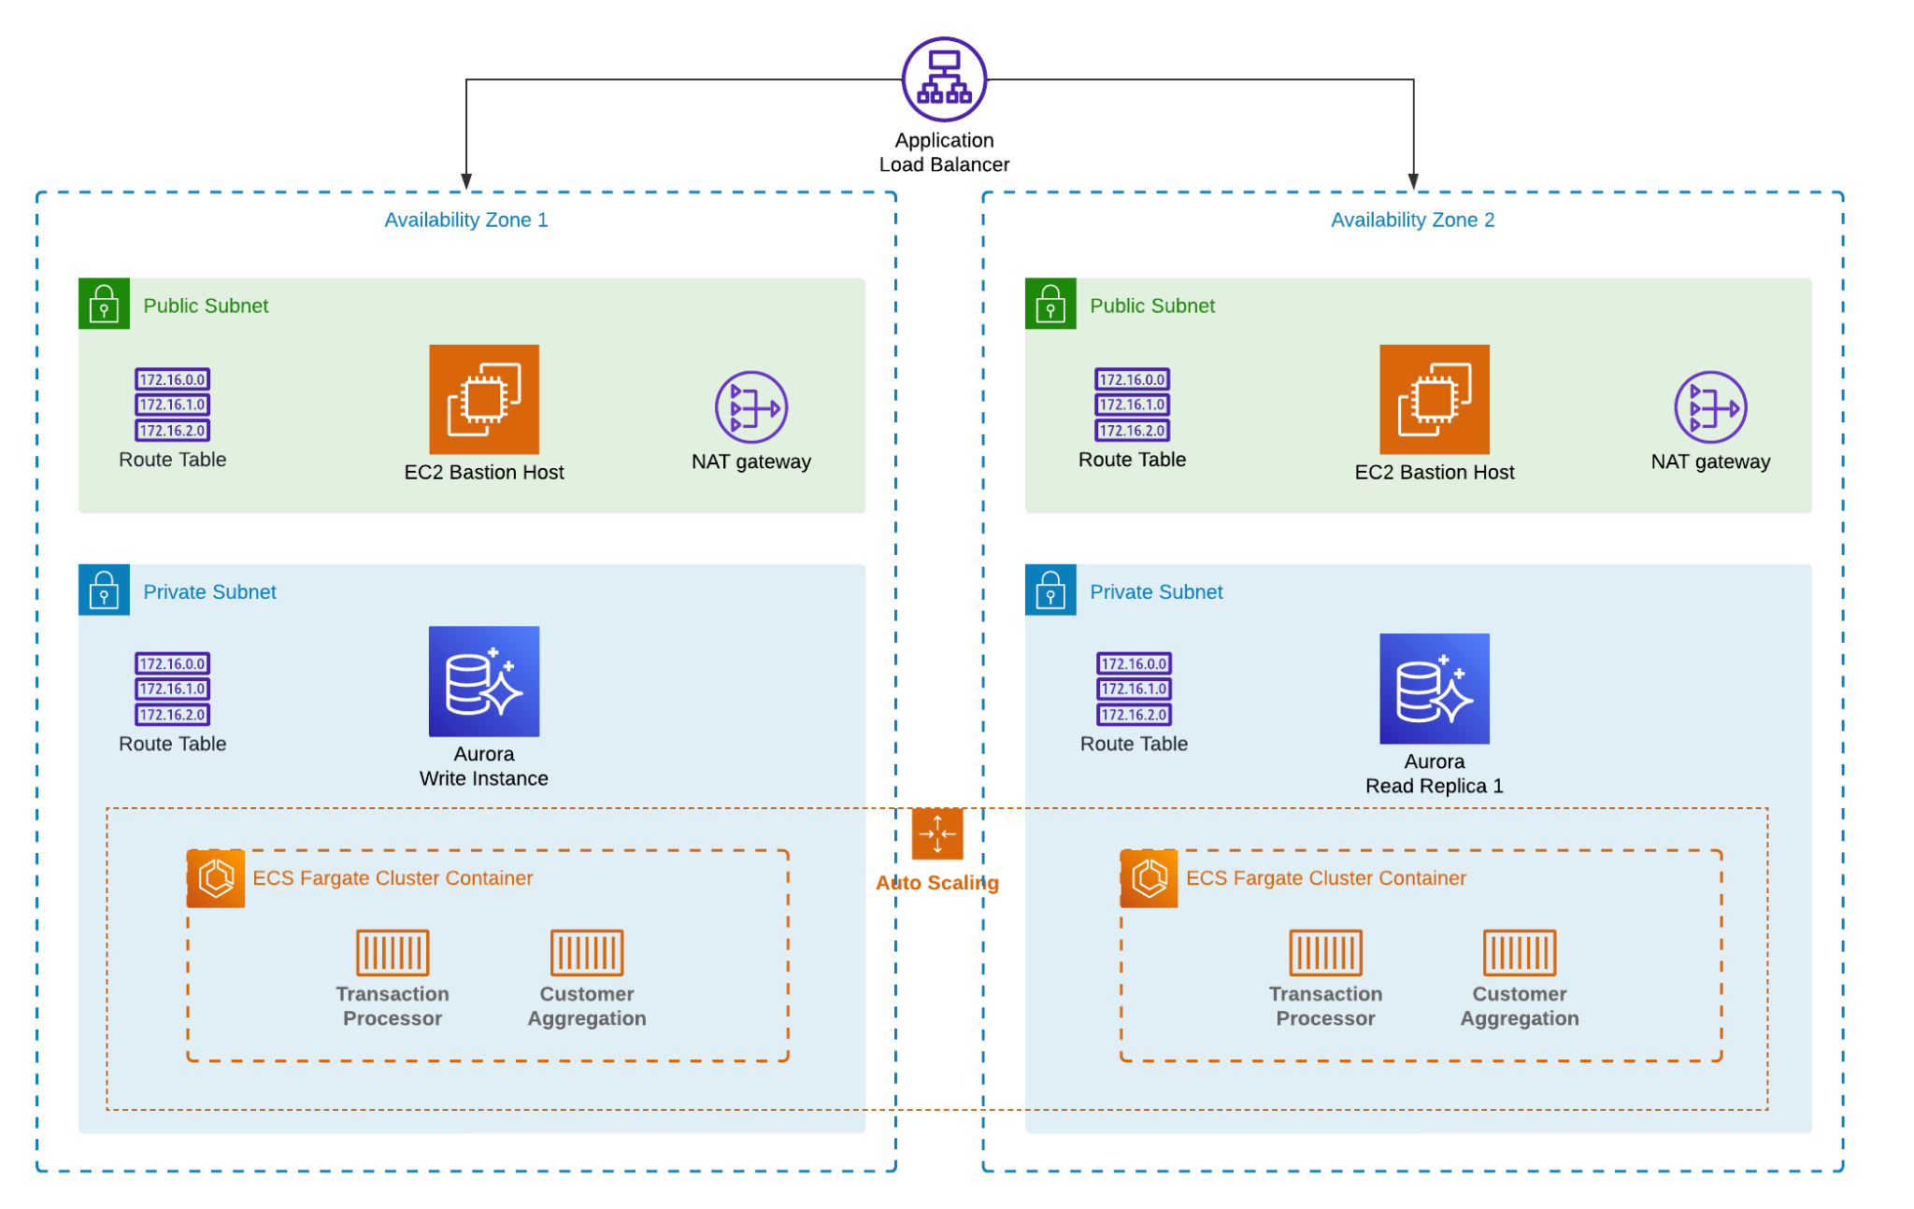
2 AZ Deployment Strategy
Project Context
Solution Overview
Maintainability
Availability
Security
Performance
Notes:
And lastly, the overall architecture is also deployed across two availability zones to have an active-active standby configuration.

Slide 29
Leveraging Serverless to achieve HA
AWS Lambda
Microservices deployed on AWS Lambda:
Data extraction from Exavault
Data ingestion from API and CSV
Notification service to send campaign emails
Amazon S3
Items we stored in S3:
Frontend application
CSV files from ExaVault
Project Context
Solution Overview
Maintainability
Availability
Security
Performance
Notes:
For our serv

Slide 30
Security
05
Notes:
darren

Slide 31

Application Firewall
AWS Web Application Firewall
Uses AWS Managed Rule Set
Implemented with CloudFront to block attacks
Helps prevent:
SQL Injection
Cross-Site Scripting
Cookie Poisoning
Potential Denial-Of-Service
Project Context
Solution Overview
Maintainability
Availability
Security
Performance

Slide 32
API Gateway
Multiple endpoints are running at the backend
API Gateway is added in front of the load balancer to act as a reverse proxy
Prevents exposure of backend services directly to the client
Project Context
Solution Overview
Maintainability
Availability
Security
Performance

Slide 33
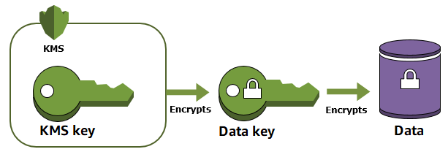

Encryption
PII and PCI data are encrypted at rest and transit (from resource-to-resource) with AWS KMS [Implemented] ✅
Project Context
Solution Overview
Maintainability
Availability
Security
Performance

Slide 34
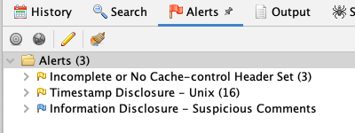
Penetration Testing - OWASP ZAP
Alerts were initially were pertaining to missing headers, non-redirection to HTTPs.
[Implemented] ✅
Deploy the frontend on S3 and link it to CloudFront
Use ACM to ensure HTTPS
[Not Implemented]❌
Manual intervention to fix low-risk threats like timestamp exposure
Project Context
Solution Overview
Maintainability
Availability
Security
Performance

Slide 35
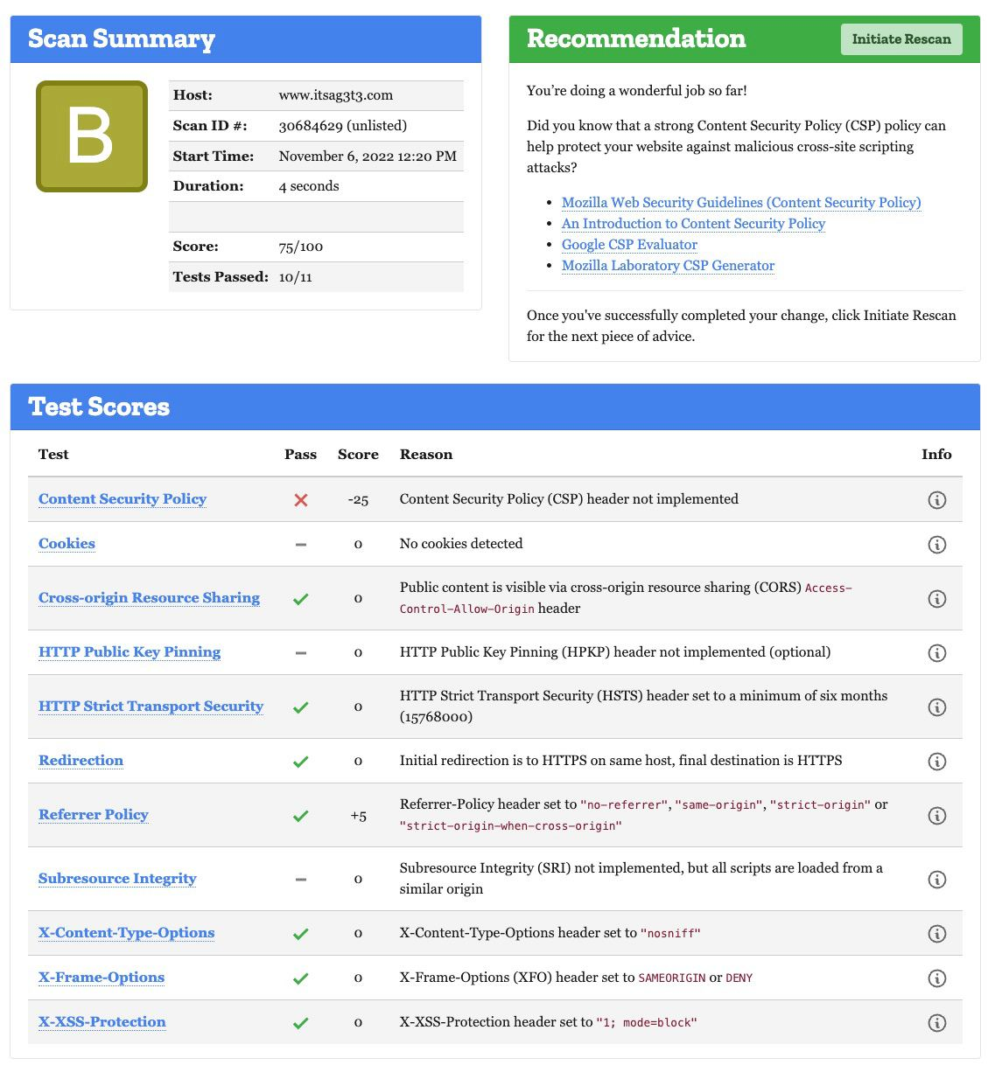
Observatory Mozilla
Security Headers are configured at CloudFront and API Gateway
Project Context
Solution Overview
Maintainability
Availability
Security
Performance

Slide 36

Key Vulnerabilities
01
Credentials as Environment Variables
Issue: Storing important credentials such as DB_PASSWORD might be leaked if an intruder gets access to the container in Fargate
Solution [Implemented] ✅:
Store all credentials in AWS Secrets Manager
Only allow access to authenticated IAM roles
Project Context
Solution Overview
Maintainability
Availability
Security
Performance

Slide 37
Key Vulnerabilities
02
Directly Access of API Gateway
Issue: API Gateway is publicly accessible. Bad actors might be able to access restricted data directly.
Solution [Implemented] ✅:
Only allow access to authenticated users with a valid API Key in their request headers.
Frontend and API Gateway are both HTTPS, preventing any MITM form of attacks.
Project Context
Solution Overview
Maintainability
Availability
Security
Performance
Notes:
Bad actors from accessing restricted data… not DDOS

Slide 38
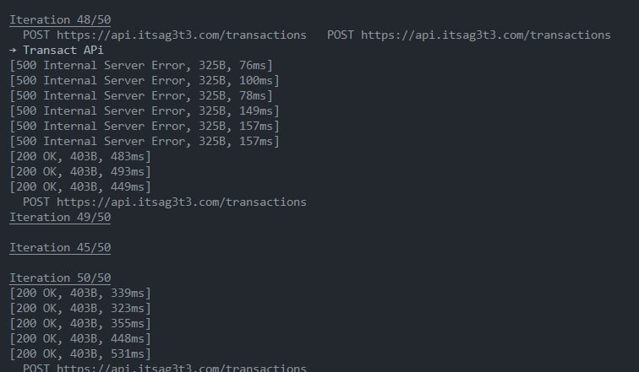
Key Vulnerabilities
02
Directly Access of API Gateway
Issue: API Gateway is publicly accessible. Intruders might directly access the gateway and attempt to perform DDoS on the gateway resulting in unnecessary throttle or worse, bring down the service all together.
Solution [Implemented] ✅:
Only allow access to authenticated users with a valid API Key in their request headers.
Frontend and Services are both HTTPS, preventing any MITM form of attacks.
Project Context
Solution Overview
Maintainability
Availability
Security
Performance

Slide 39
Key Vulnerabilities
03
PII and PCI Data
Issue: As of now PCI and PII data are only encrypted at rest and at transit with KMS. There might be a possibility of an internal leak and unauthorised developers get access to the users’ data.
Solution [Implemented] ✅:
Encrypted at rest using managed keys by AWS
Solution [Not implemented] ❌:
Finding leakage
Scan the data with Amazon Macie (to find leakage)
Project Context
Solution Overview
Maintainability
Availability
Security
Performance
Notes:
Amazon Macie

Slide 40
Key Vulnerabilities
04
Potential Network Attacks
Issue: The access to the private subnet hosting our backend microservices and databases are currently limited by security groups and NACLs. There may be potential ‘direct-access’ externally if these were not configured properly.
Solution [Implemented] ✅:
Configure the NACL and Security Groups to make sure all the public requests to hit the API Gateway (hosted in public subnet)
Only API Gateway and ALB is allowed to access the backend services
Only the ALB is allowed to access the DB
Project Context
Solution Overview
Maintainability
Availability
Security
Performance

Slide 41
Performance
06
Notes:
stephen

Slide 42
AWS Lambda
Hosts functions that perform:
API endpoint processing
Scaling TPs
Processing SQS messages
Serverless, scales with user requests
Able to handle several triggers in parallel
Project Context
Solution Overview
Maintainability
Availability
Security
Performance
Notes:
We use AWS Lambda to host 3 of our functions for API endpoint processing, scaling transaction processors, and processing SQS queue messages As AWS Lambda is serverless, it can easily scale with the amount of user requests that flow through. Additionally, AWS Lambda is able to handle several triggers from these functions in parallel, so this speeds up the processing of our lambda function, since each trigger is individually handled.

Slide 43
Microservices with Amazon ECS Fargate
Using AWS Fargate
Automatically manages the running of ECS containers
Enables ECS containers to be launched in seconds
Allows our microservice instances to be spun up automatically and quickly.
Project Context
Solution Overview
Maintainability
Availability
Security
Performance
Notes:
The microservices in our solutions are deployed inside ECS containers within a cluster. We used Fargate because of its benefit of managing the infrastructure of running containers. So in terms of performance, Fargate enables ECS containers to be quickly launched, which in turn allows our microservices to spin up quickly for fast scaling.
https://docs.aws.amazon.com/AmazonECS/latest/developerguide/AWS_Fargate.html

Slide 44
Message Queues with Amazon SQS
Message queues enable asynchronous communication
Endpoints that are producing and consuming messages interacts with the queue, not each other
Services can add requests to the queue without waiting for processing
Dead-letter queues to handle failed messages
Enables Concurrency for Message Processing
2 Transaction Processor services processing messages from the transaction queue
Speeds up process
Project Context
Solution Overview
Maintainability
Availability
Security
Performance
Notes:
We also have several message queues created through Amazon SQS for ingesting transactions and notification messages. These message queues allow for asynchronous communication between API endpoints, so that there is no waiting involved in the process. We also have dead-letter queues to handle any message failures by rerouting them from the main queue. Currently these messages will be handled manually.
Our queues also enable concurrent message processing. So for example, 2 transaction processor services can process messages from the transactions queue, so this will help speed up the overall transaction process
### these transaction services can add messages to the queue without having to wait for them to be processed by the other endpoint.

Slide 45

Amazon Aurora
Setup
2 Read Nodes
1 Write Node
Aurora synchronously replicates data across AZs.
Provides data redundancy, promote high availability
Eliminate I/O Freezes
Minimize latency spikes during back-ups
Project Context
Solution Overview
Maintainability
Availability
Security
Performance
Notes:
We have set it up such that there are 2 read nodes and 1 write node. These 2 read nodes will synchronously replicate data across AZs to the different storage nodes in our cluster. This helps to provide data redundancy, prevent I/O freezes, as well as minimizing the latency spikes during system backups, since the data is always up to date. As my teammate had mentioned, while AWS Aurora is more expensive, its’ benefits provided a good increase in its performance and availability

Slide 46
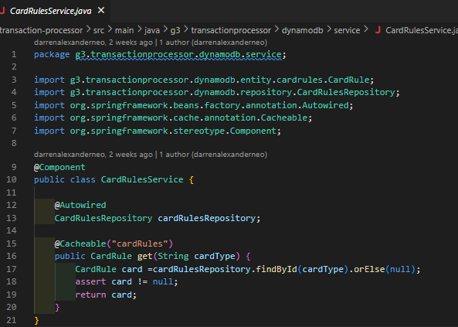
Caching (In-memory)
Transaction Processor service uses @Cacheable
In-memory cache to store card rules from DynamoDB
Refreshes every hour
No need to constantly query for rules
Saves time needed to retrieve the rules
Project Context
Solution Overview
Maintainability
Availability
Security
Performance
Notes:
We also have in-memory caching set in our Transaction Processor, using Spring Boot’s framework. This in-memory cache is set every hour to help to store card rules from our DynamoDB. This saves time, as there is no need to constantly query for the rules everytime a transaction is made.

Slide 47
Amazon CloudFront with S3
Low latency Content Delivery Network (CDN) to control flow of data
Allows caching on edge locations - allows faster retrieval of resources
CloudFront allows solution to work even when S3 is down, does not affect performance.
Project Context
Solution Overview
Maintainability
Availability
Security
Performance
Notes:
Lastly, our team also made use of AWS Cloudfront to control flow of data more smoothly. CloudFront will retrieve the necessary web files from S3 by retrieving it from the edge location cache in order to achieve lowest latency, which will boost the speed of processing the webpage for users.
CloudFront also allows our solution to continue functioning even if S3 is down, allowing it to continue performing by retrieving data from the cache.

Slide 48

Performance Demo
Project Context
Solution Overview
Maintainability
Availability
Security
Performance

Slide 49
Thank You!
Do you have any questions?

